Slide 1
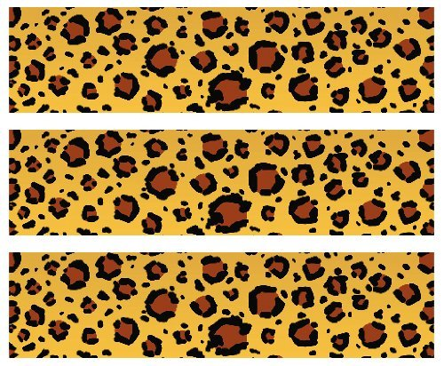

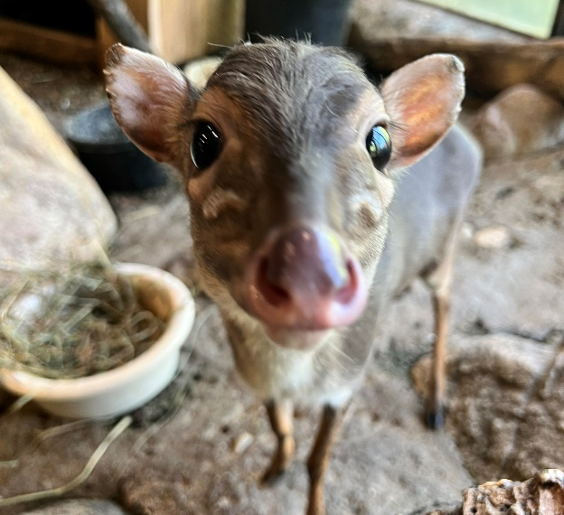
Blue Duiker
Habitat: Wide range of forest and wooded habitats in Central, Eastern, and Southern Africa
Size: 7-10 pounds
12-16 inches tall
Life Span: 5 years
Diet: Fruit, leaves, flowers, fungi, seeds and sometimes insects, eggs and small animals
Reproduction: 1 fawn after 210 days
Conservation Status
Extinct
Extinct in the wild
Critically Endangered
Endangered
Vulnerable
Near Threatened
Least Concern
Did You Know?
Blue Duikers mate for life!
Due to: habitat loss, hunting, declining food supply

