Slide 1
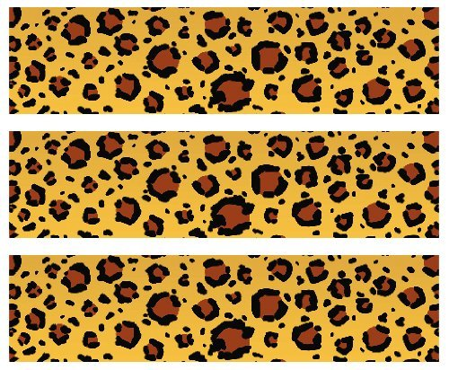

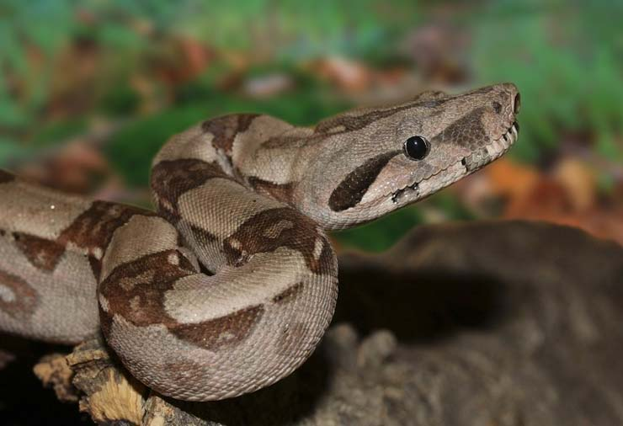
Central American Boa
Habitat: High cloud forests to dry lowlands in Central and South America
Size: 6-12 feet
40-50 pounds
Life Span: 20-30 years
Diet: mammals, birds, amphibians, lizards and other snakes small enough to swallow whole
Reproduction: up to 60 live young after 70-100 days
Conservation Status
Extinct
Extinct in the wild
Critically Endangered
Endangered
Vulnerable
Near Threatened
Least Concern
Did You Know?
When threatened, boa constrictors will hiss so loudly that they can be heard up to 100 feet away.
Due to: habitat loss, hunting

