Slide 1
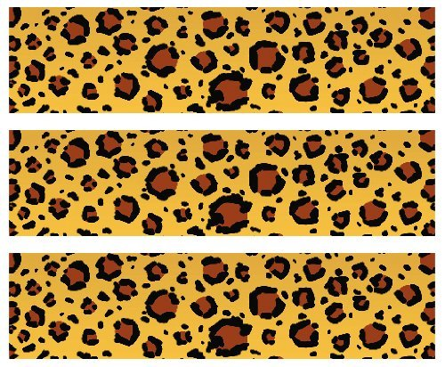

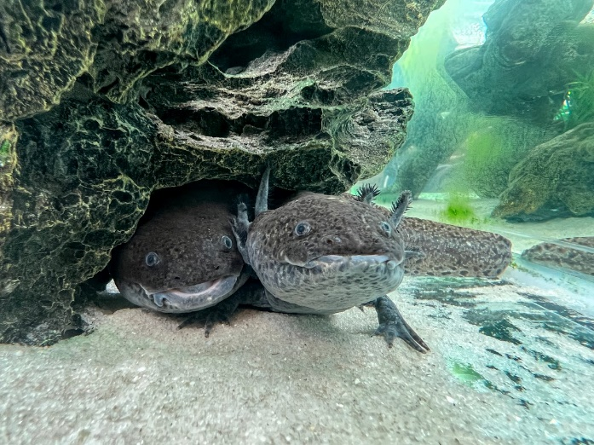
Axolotl
Habitat: High altitude lakes in Lake Xochimilco in Mexico
Size: 2-8 ounces
9-12 inches
Life Span: 10-15 years
Diet: mollusks, worms, insect larvae, crustaceans, some fish
Reproduction:100-300 eggs that incubate for 10-14 days
Conservation Status
Extinct
Extinct in the wild
Critically Endangered
Endangered
Vulnerable
Not Threatened
Least Concern
Did You Know?
When an axolotl loses a limb, tail, organ, parts of the eye, brain or even a bit of its heart, that body part regrows!
Due to: water waste, predatory fish, habitat loss, drought, illegal pet trade

