Slide 1
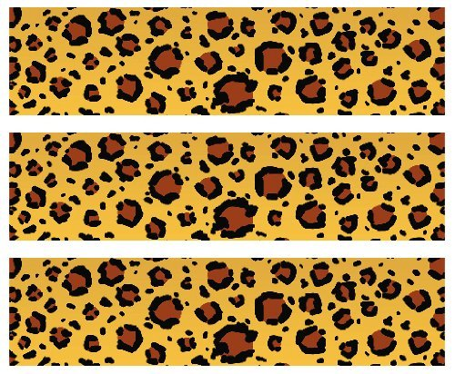

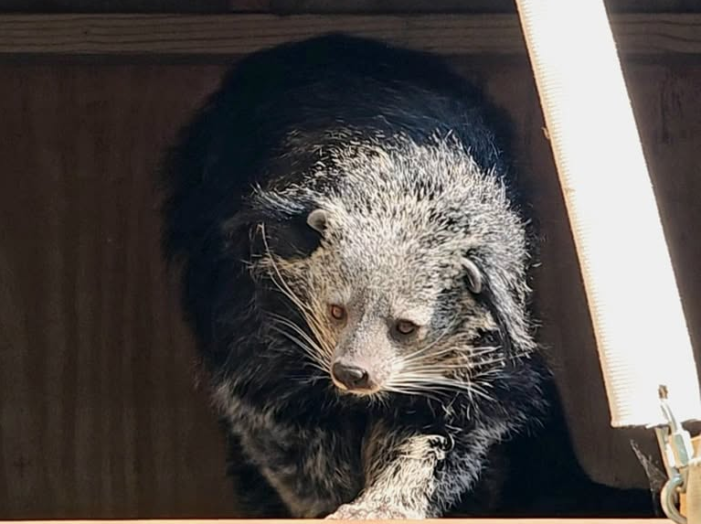
Binturong
Habitat: Tree canopies of dense, tropical and subtropical rainforests in South and Southeast Asia
Size: 30-50 pounds
2-3 feet
Life Span: 15 years for females
18 years for males
Diet: fruits and berries, occasionally small animals
Reproduction:2-6 babies after 90-92 days
Conservation Status
Extinct
Extinct in the wild
Critically Endangered
Endangered
Vulnerable
Not Threatened
Least Concern
Did You Know?
Binturong urine smells like buttered popcorn because it contains the same chemical as cooked popcorn
Due to: habitat loss and hunting

