Slide 1
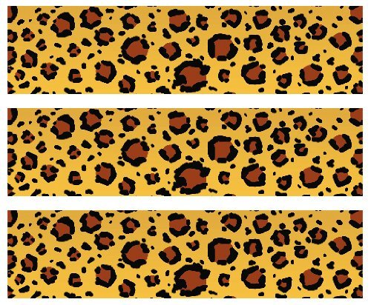

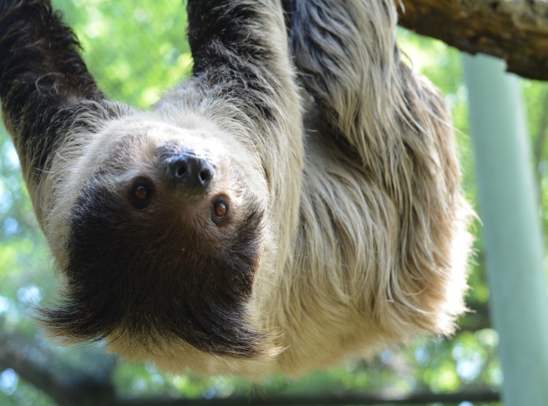
Linnaeus Two–toed Sloth
Habitat: Lowland and montane tropical forests
Size: around 2 feet long; weigh 8-25 pounds
Life Span:12-20 years
Diet: leaves, shoots and fruit
Reproduction: A single young after a 7-10 month gestation period
Conservation Status
Extinct
Extinct in the wild
Critically Endangered
Endangered
Vulnerable
Near Threatened
Least Concern
Did You Know?
Sloths are better at swimming than at walking! They eat, sleep, breed and nurse upside-down!
Threats:
Habitat Destruction and illegal pet trade

