Slide 1
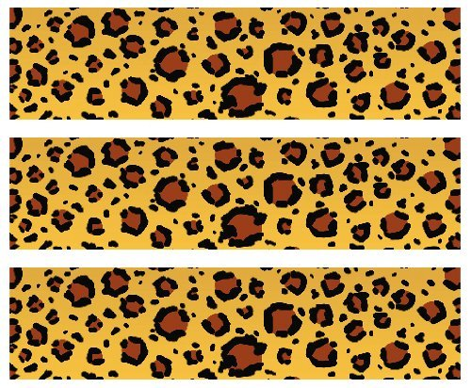

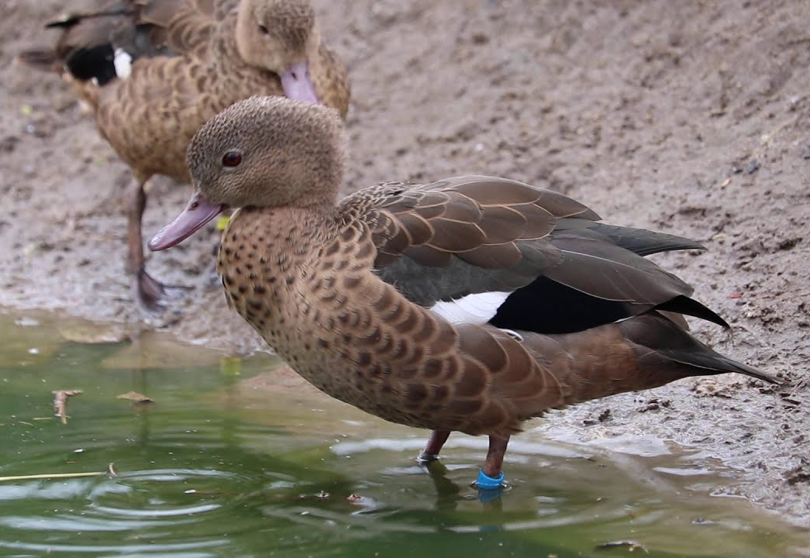
Madagascar Teal
Habitat: Coastal Lakes, Mangrove Forests, and Estuaries in Madagascar
Size: 15-17 inches
0.6-0.8 pounds
Life Span: 10 years
Diet: Small invertebrates, plant matter, and insects
Reproduction: 2-10 eggs that incubate for 28 days
Conservation Status
Extinct
Extinct in the wild
Critically Endangered
Endangered
Vulnerable
Near Threatened
Least Concern
Did You Know?
They wade in shallow water and feed by dabbling – it lowers its head in the water and filters food items through its bill.
Due to: habitat loss, hunting

