Slide 1
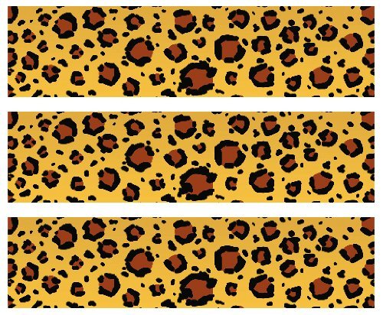

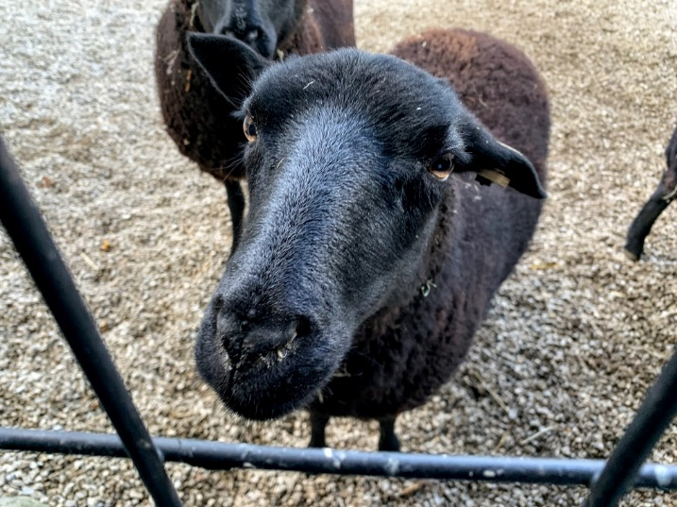
Black Welsh Mountain Sheep
Habitat: Hills, grasslands, farmlands
Size: 20-30 inches at the shoulder
Females:100 pounds
Males: 132-143 pounds
Life Span: 10-12 years
Diet: Grasses, hay, grain
Reproduction: 1-2 babies after 149-155 days
Conservation Status
Extinct
Extinct in the wild
Critically Endangered
Endangered
Vulnerable
Near Threatened
Least Concern
Did You Know?
The wool of this sheep is fine, soft and dense. The average fleece weighs 2.5-4 pounds.
Due to: disease outbreaks, genetic bottlenecks, and environmental changes

