Slide 1
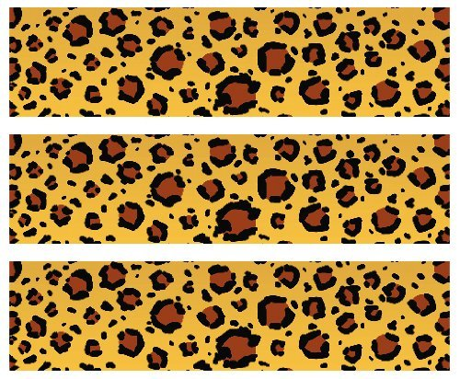

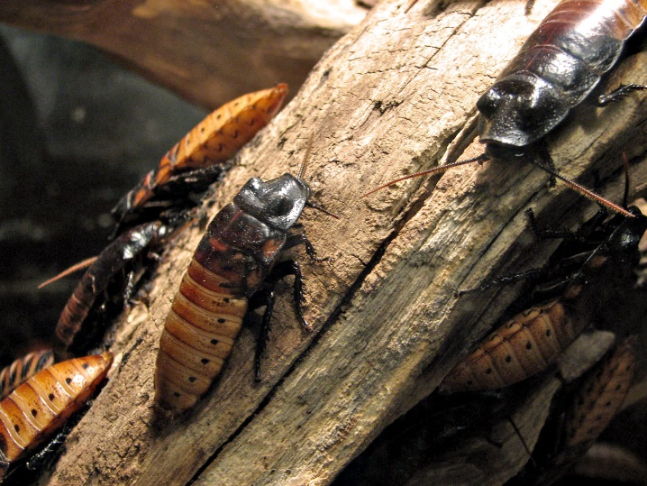
Madagascar Hissing Cockroach
Habitat: Rainforest floor in Madagascar
Size: 4 inches
.3 ounces
Life Span: 4 years
Diet: Rotting foliage and produce
Reproduction: 100-150 live young that are born after about 60 days
Conservation Status
Extinct
Extinct in the wild
Critically Endangered
Endangered
Vulnerable
Near Threatened
Least Concern
Did You Know?
Hissing cockroaches startle predators by emitting a hissing sound. That sound is caused as air is forced out of their spiracles (holes down the sides of the thorax and abdomen that are used for breathing)
Due to: deforestation

